Slide 1

Social Media
comment classification
Crime Forecasting
Sravan Dwadasi
Seelam Ram mohan Reddy
CH Sai Ganesh
G Vidya Charan

Slide 2

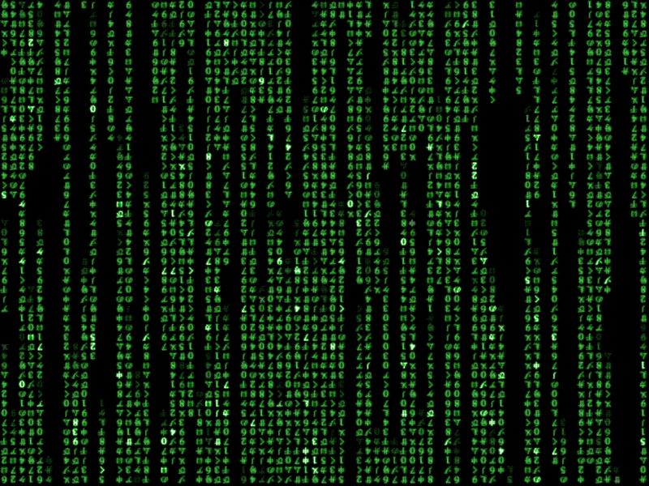

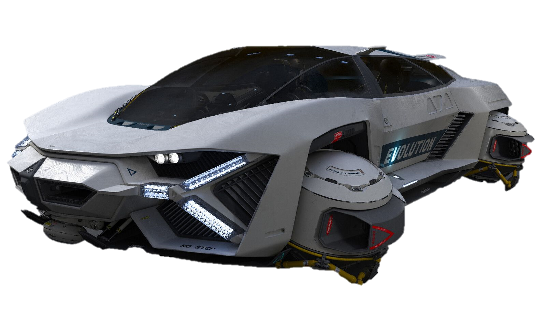
Social Media
comment classification
Crime Forecasting
Mentor
Dr Divya Udayan J
Sravan Dwadasi
Seelam Ram mohan Reddy
CH Sai Ganesh
G Vidya Charan

Slide 3
Mini Project Summary
Carpooling is a form of transportation in which multiple people share a single vehicle to travel together reducing the number of cars on the road traffic congestion and air pollution
Social Media
comment classification
Crime Forecasting

Slide 4
Challenges and problems
Scheduling Conflicts
Reliability
Safety and Privacy Concerns
Lack of flexibility
Limited Options
Sravan Dwadasi
Seelam Ram mohan Reddy
CH Sai Ganesh
G Vidya Charan

Slide 5
introduction
Cybercrime is a global concern due to criminals exploiting social media users to commit illegal activities
Social media provides an opportunity for criminals terrorists and ordinary users to make threats to other people allowing them to abuse and humiliate people
Sravan Dwadasi
Seelam Ram mohan Reddy
CH Sai Ganesh
G Vidya Charan

Slide 6
Literature Review Summary
S NO | Author | Paper Title | Findings
1. | Shah N Bhagat N Shah M | Crime forecasting a machine learning and computer vision approach to crime prediction and prevention | Machine Learning approaches yield a maximum score of 0.9162, but Deep Learning (DL) techniques can achieve a large margin over this score.
2. | Fatima Dakalbab, Manar Abu Talib, Omnia Abu Waraga, Ali Bou | Artificial intelligence & crime prediction | A hybrid BERT model was used to achieve an accuracy of 99% and an F1-score of 0.89, addressing the issue of unfairness in ML models.

Slide 7
s NO | Author | Paper Title | Findings
3. | W. Safat, S. Asghar and S. A. Gillan | Empirical Analysis for Crime Prediction and Forecasting Using Machine Learning and Deep Learning Techniques | This paper, assessment of various deep learning models fed by various word embedding representations to detect toxicity within textual comments. The LSTM-based model is the first choice among the experimented models to detect toxicity.
4. | Jenga, K., Catal, C. Kar, G | Machine learning in crime pre-diction. | Compares the performance of several basic machine learning algorithms. The authors find that random forest performs the best in terms of precision, recall, and F1 score.

Slide 8
Problem Definition
Crime prevention and investigation are essential for public safety and social media platforms can help
NLP and machine learning methods are needed to categorize social media comments and predict crime
NLP and machine learning approaches are used to categorize social media comments and predict crime
Social Media
comment classification
Crime Forecasting

Slide 9
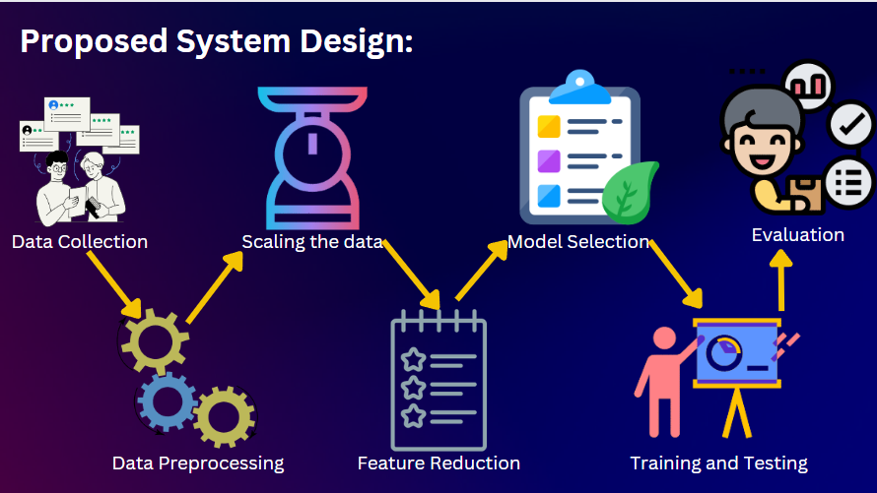

89.716 %
Random Forest
91.591 %
Logistic Regression
Ada Boost
90.489%
KNN
Decision tree
LSTM
XG Boost

Slide 10
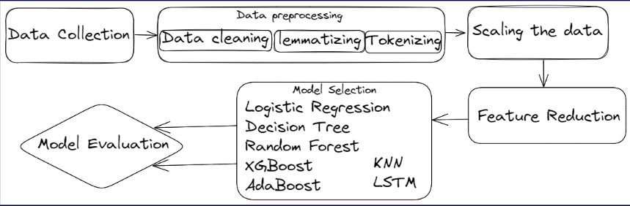
Pipeline of the proposed methodology
89.716 %
Random Forest
91.591 %
Logistic Regression
Ada Boost
90.489%
KNN
Decision tree
LSTM
XG Boost

Slide 11
Implementation Details
89.716 %
The idea is to use the training dataset to train the models with the words in the comments as predictor variables and to predict the probability of the toxicity level of a comment
Our project is focused on developing a series of machine learning and deep learning models The goal is to use different ML and Deep Learning models to classify the comments and identify toxicity levels
Random Forest
91.591 %
Logistic Regression
Ada Boost
90.489%
KNN
Decision tree
LSTM
XG Boost

Slide 12
Logistic Regression
89.716 %
Random Forest
91.591 %
Ada Boost
90.489%
KNN
Decision tree
LSTM
XG Boost

Slide 13
Logistic Regression
89.716 %
Logistic regression predicts binary outcomes
It models the relationship between predictor variables and the outcome
Effective use requires an understanding of the data preprocessing and proper evaluation as well as awareness of potential issues
Random Forest
Ada Boost
KNN
Decision tree
LSTM
XG Boost

Slide 14
Random Forest
Logistic Regression
91.591 %
Ada Boost
90.489 %
KNN
90.752 %
Decision tree
LSTM
XG Boost

Slide 15
Random Forest
Logistic Regression
91.591 %
Random forest classifier improves the accuracy and robustness of the model
Decision trees are aggregated to create a final classification
Random training reduces overfitting and increases generalization performance
High accuracy scalability and ability to handle noisy data
KNN
Ada Boost
Decision tree
LSTM
XG Boost

Slide 16
Random Forest
Ada Boost
90.489 %
KNN
90.752 %
Decision tree
86.206 %
XG Boost
LSTM

Slide 17
Ada Boost
Random Forest
90.489 %
Adaboost classifier combines weak learners to create a strong classifier
Adaboost classifier trains weak classifiers to focus on misclassified samples
Adaboost classifier has high accuracy, but is slower and more computationally intensive
KNN
Decision tree
XG Boost
LSTM

Slide 18
Ada Boost
KNN
90.752 %
Decision tree
86.206 %
XG Boost
91.617 %
LSTM

Slide 19
KNN
Ada Boost
90.752 %
Decision tree
KNN is a popular machine learning algorithm for classification and regression tasks
KNN is useful for nonlinear relationships and complex data structures
It requires careful selection of the number of neighbors k and the distance metric used to measure the similarity between data points
XG Boost
LSTM

Slide 20
KNN
Decision tree
86.206 %
XG Boost
91.617 %
LSTM
99.425%
LSTM

Slide 21
Decision tree
KNN
91.617 %
Decision tree classifier creates a tree like model of decisions and consequences
Nonlinear relationships between features and target variables can be identified
Pruning limiting depth and ensemble methods can reduce overfitting
XG Boost
LSTM

Slide 22
XG Boost
Decision tree
91.617 %
LSTM
99.425%

Slide 23
`
XG Boost
91.617 %
Decision tree
XGBoost optimizes loss function by adding decision trees sequentially
XGBoost can be used for both regression and classification problems
It supports various objective functions and evaluation metrics
LSTM

Slide 24
XG Boost
LSTM
99.425%

Slide 25
LSTM
XG Boost
99.425%
LSTM Long Short Term Memory is a type of recurrent neural network RNN that can handle long term dependencies in sequential data
Memory cells store and control information flow
LSTM is a powerful deep learning algorithm with excellent performance

Slide 26
Experimental Results
Grid search CV is used to tune hyperparameters in machine learning
Grid search cv reduces time for machine learning algorithms
LSTM and XGBoost perform well in machine learning and deep learning algorithms respectively

Slide 27
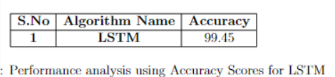
Experimental Results
From the research of analyzing the toxic comments classification and forecasting it was said that deep learning algorithms will perform better than the normal machine learning algorithms
Grid search CV is used to tune hyperparameters in machine learning
Grid search cv reduces time for machine learning algorithms
LSTM and XGBoost perform well in machine learning algorithms

Slide 28
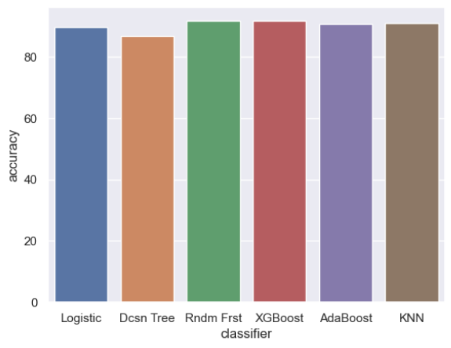
Accuracy Scores for different algorithms

Slide 29
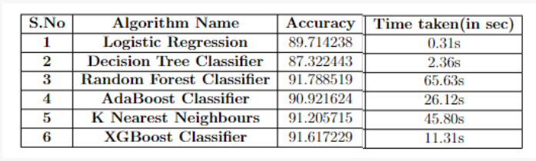
Test and Analysis
Performance analysis using Accuracy Score

Slide 30
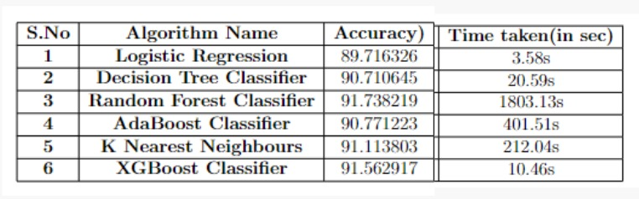
Test and Analysis
Performance analysis using Accuracy Score using Grid Search CV

Slide 31
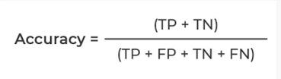
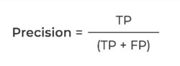
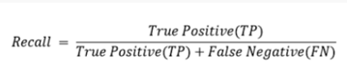
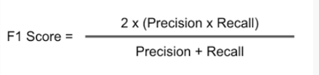

Slide 32
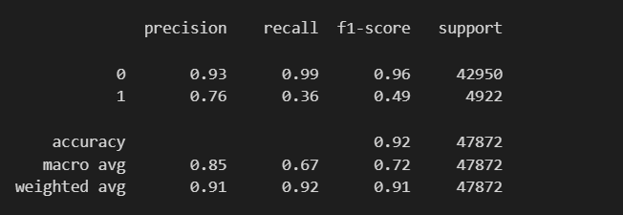
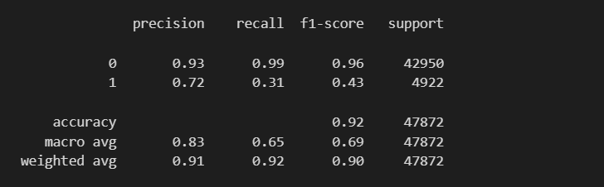
Random Forest Classifier
Classification Reports
XGBoost Classifier

Slide 33

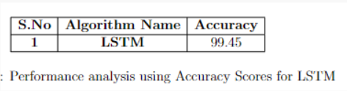

Results and Discussion
As concluded in the research deep learning algorithms will perform better when compared with normal machine learning algorithms
After the implementation LSTM performs very well than the normal machine learning algoithms And in the machine learning algorithms XGBoost performs well with a comparatively good accuracy score

